Slide 1
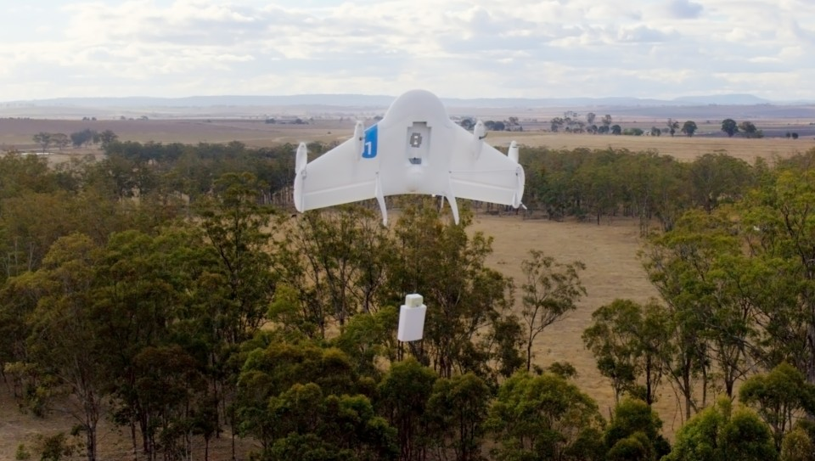
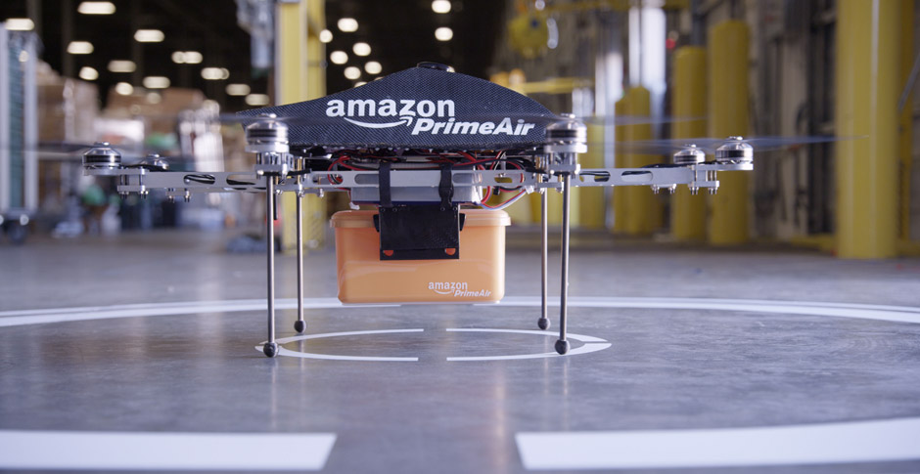
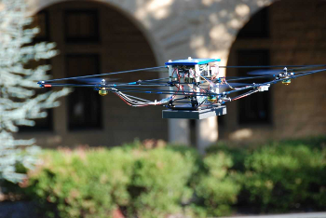
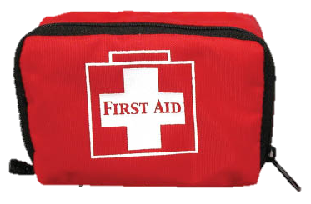
UAV Platooning and Air Highways
Google Project Wing
Amazon Prime Air
UAV Traffic Management
Hybrid Systems Laboratory
Emergency Supply Delivery
Search and rescue
Aerial surveillance
Notes:
Recently, there have been immense interest in using UAVs for civil purposes such as package delivery, emergency supply delivery, aerial surveillance, and search and rescue. In the future, the uses of UAVs are only limited by our imagination.

